Slide 1


Project Roadmap: LLM-Based Differential Diagnosis
University of Illinois at Urbana-Champaign – Wolters Kluwer

Slide 2
Project objectives
Our goal is to investigate how advanced language models from OpenAI, Google, Anthropic, or DeepSeek can improve clinical decision-making for physicians and enhance patient care.
To achieve this goal, we would be developing standardized prompting structures that corroborate our research results^{[1]}.
  Clinical Application Goals
    Generate a probable list of diagnoses from case data.
    Recommend patient management strategies.
    Propose follow-up steps and relevant tests.
  Evaluation Criteria
    Accuracy of Diagnosis: Validating the correctness and relevance of suggested diagnoses.
    Chain-of-Thought: Assessing the clarity and depth of the model’s reasoning process.
[1] Superhuman performance of a large language model on the reasoning tasks of a physician - link

Slide 3
Typical Clinical Pathway
d
Patient visits doctor
Doctor reviews concerns and past medical history
Doctor asks clarifying questions
Initial Evaluation
  Patient states their chief complaint and present symptoms.
Collects History of Present Illness (HPI), Past Medical History (PMH), Past
Surgical History (PSH), Medication/Allergy History, Family History, and Social History to build complete clinical picture.
Conducts a Review of Systems (ROS) to uncover additional symptoms and refine clinical context.
d
Doctor forms differential diagnoses
Doctor prescribes tests
Patient undergoes tests and shares results
Diagnostic Workup
Performs a physical examination and creates a list of possible conditions.
Orders diagnostic tests (lab work, imaging etc.) to confirm or rule out each potential diagnosis.
Returns with findings for further evaluation.
d
Doctor prescribes final treatment
Patient undergoes treatment and follow-up
Treatment and Follow-up
Confirms the final diagnosis, outlines a treatment plan, and provides patient education on management and preventive measures.
Follows the recommended plan, attends follow-up appointments, and receives additional evaluations or adjustments as needed.

Slide 4
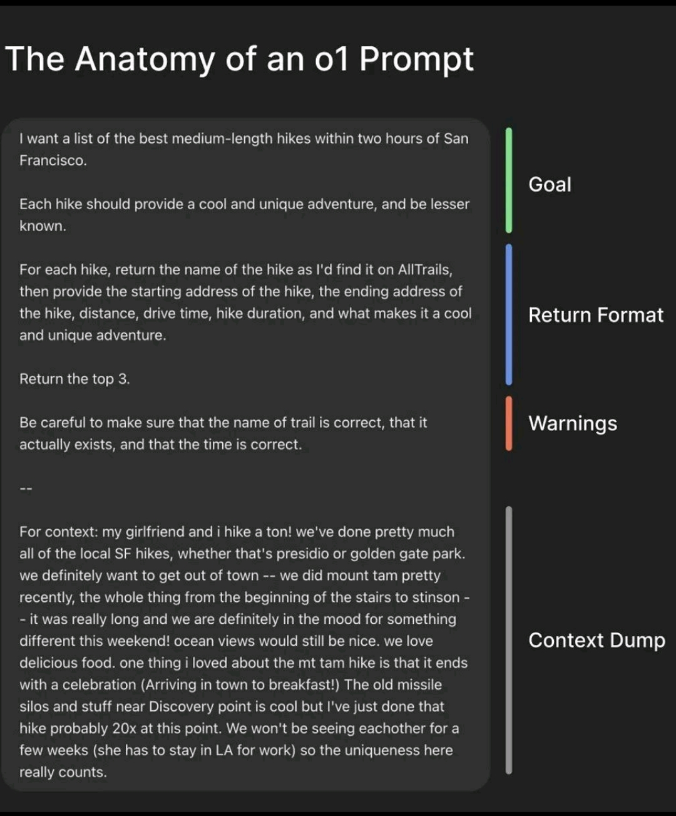
Milestones for Initial Evaluation
Patient visits doctor
Doctor reviews concerns and past medical history
Doctor asks clarifying questions
Objective:
We will mimic the second step of this segment by creating the Context Dump^{[1]} needed for an effective prompt. The necessary information will be gathered from The New England Journal of Medicine case records.
Tasks:
Directly interface with LLMs via their application website to enter case records and generate key metrics – HPI, PMH, and PSH.
Use application code via OpenAI or Gemini API tokens to automate the above process once the manual method yields satisfactory results.
Challenges:
Converting imagery data (x-rays and scans) to textual data for advanced reasoning models.
Stretch goal:
Creating synthetic EHRs from case data to mimic real-world scenarios and reference them in prompts.
[1] The Anatomy of an o1 Prompt - link

Slide 5
Milestones for Diagnostic Workup
Doctor forms differential diagnoses
Doctor prescribes tests
Patient undergoes tests and shares results
Objective:
Once satisfactory results are achieved for providing context to the LLM, we will start creating prompts to elicit differential diagnosis (1st step in the above workflow) from the advanced LLMs.
Tasks:
Divide the dump of NEJM case records into training and testing data sets.
Using the prompt structure highlighted in the previous slide, we will work on the following strategies:
  Having the training and testing data sets in the same prompt.
  Providing the training datasets in one prompt and the testing data sets in subsequent prompts within the same chat.
  Training the LLM in a separate chat and testing it in a separate chat leveraging learned-memory of LLMs.
Perform the same actions using application code.
Challenges:
Converting imagery data (x-rays and scans) to textual data for advanced reasoning models.
Feasibility of doing the above tasks using APIs because of token restrictions.
Stretch goal:
Think of alternative or creative ways to achieve said results. – Need more clarity or technical expertise to evaluate.

Slide 6
Milestones for Treatment and Follow-up
Doctor prescribes final treatment
Patient undergoes treatment and follow-up
Objective:
Once satisfactory results are achieved for getting the differential diagnoses based on the success metrics mentioned in slide 2, we will enhance the prompts to elicit next steps and patient management strategies from the advanced LLMs. To wrap up the project, we will provide a Product Requirement Document on integrating advanced Clinical Decision Systems with UpToDate.
Tasks:
Ask the LLM to provide next steps like diagnostic tests and follow-up care instructions. The same methodology as described in the previous slide will be followed (all in one message vs different message in same chat vs different chats).
Perform the same actions using application code.
Draft a rough product roadmap of integrating our observations and outcomes to Wolters Kluwer UpToDate.
Challenges:
Feasibility of doing the above tasks using APIs because of token restrictions.
(Stretch goal) No formal way of evaluating the probabilistic reasonings given by the LLM.
Stretch goal:
Retrieve branching strategies or probabilistic reasoning based on the prescribed test results from LLMs.

